Slide 1
17.02. The Web Note App overview
Build a full web app for taking and searching notes.
1) Upon first launch, it should ask the user for a first name and once 2) submitted display a "Welcome username" message. 3) On all subsequent launches of the app, even if the browser was closed in between, the homepage should say "Welcome back, username".
4) The homepage features a menu with the following choices:
Add a note -> The user should be able to add a new note and the app will save it in a file.
View all notes –> The user should be able to see all the notes on one page.
Search -> The user should be able to search for a note and the corresponding notes should be displayed on a results page.
5) The app should have a bit of styling.
6) The app should be built using the Flask web framework.
7) Each major step taken in building the app is properly committed to Git with a descriptive commit message.

Slide 2
Start
1) Ask the user for a first name
Input
2) Submit display a "Welcome username" message
Output
3) On all subsequent launches of the app, even if the browser was closed in between, the homepage should say "Welcome back, username".
Output
4) The homepage features menu with
a) Add a note -> The user adds a new note and the app will save it in a file.
b) View all notes –> The user sees all the notes on one page.
c) Search -> The user searches for a note and the corresponding notes should be displayed on a results page
Input
Output
Input + Output => HTML+CSS
5) The app should have a bit of styling.
Output => HTML+CSS
6) The app should be built using the Flask web framework.
Output
Web app for taking and searching notes

Slide 3
1) Ask the user for a first name -> What’s your name?
2) Display a "Welcome username" message
3) Keep “Welcome username” message
4) Add functionalities
Button add a note
Button view all notes
Button send
5) Style the app CSS + HTML
6) Built the app in the Flask web framework

Slide 4
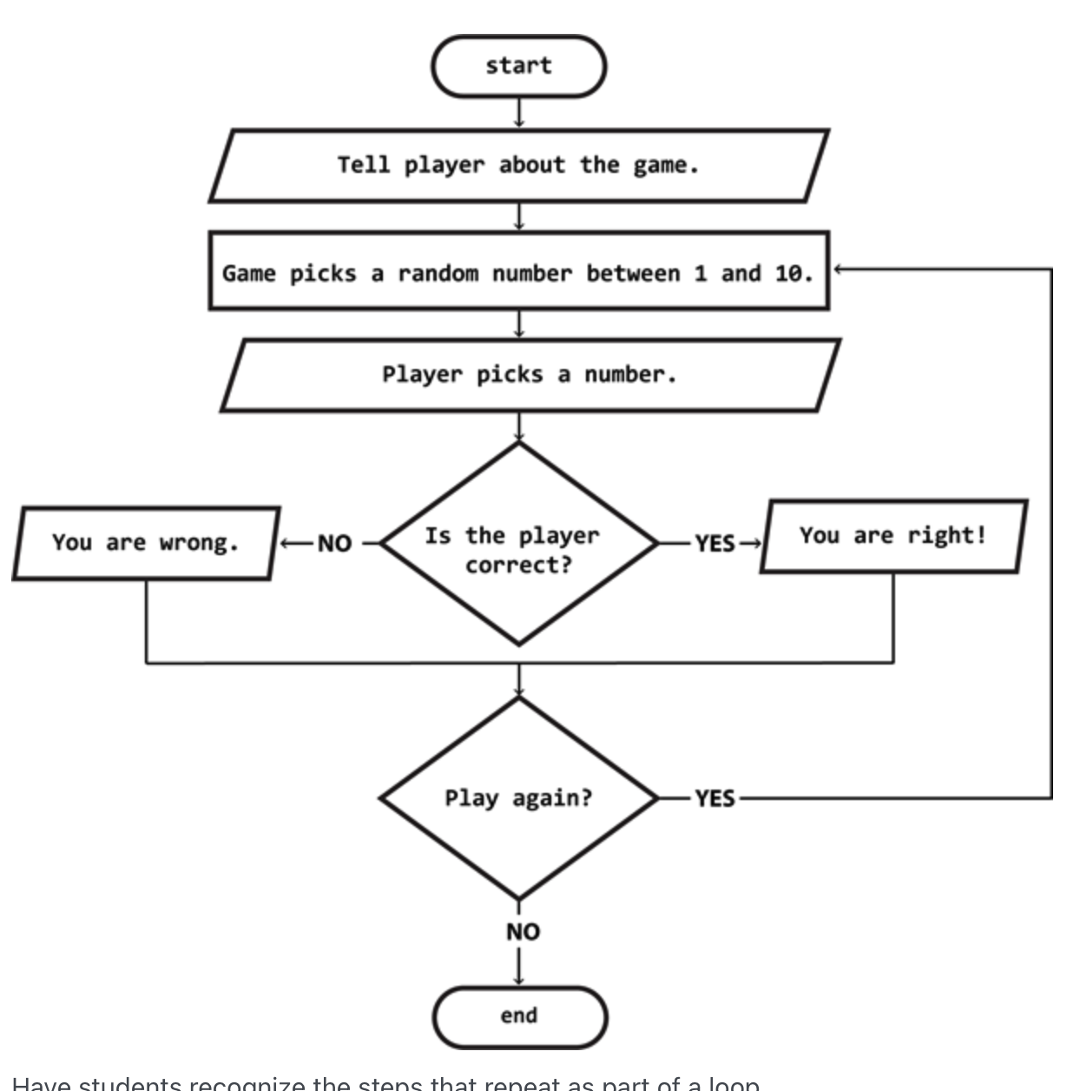

Slide 5
